Slide 1
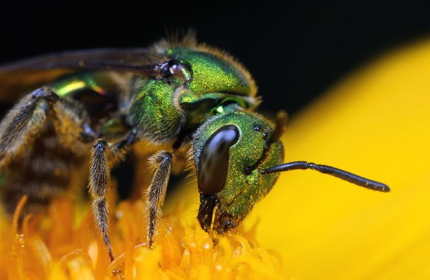
Growing Flowering Plants That are Safe for Pollinators in the Yard and Garden
David Smitley, September 30, 2014
Michigan State University
A type of sweat bee, one of 4,000 spp. of native bees in the USA

Slide 2
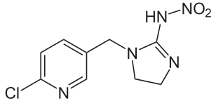
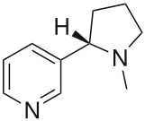
What are neonicotinoid insecticides? Neonicotinoids are a group of insecticides with a chemical structure that is similar to nicotine.
Imidacloprid Nicotine
They are more selective (e.g. they have greater toxicity to insects than to mammals), and are less harmful than most older classes of insecticides. The most widely used neonicotinoid insecticide, imidacloprid, is less toxic to people than caffeine, and about twice as toxic as ibuprofen.

Slide 3
Neonicotinoid Insecticides Used for Pest Control on Ornamentals¹
Neonic insecticides given to bees orally | Honey bees Lowest lethal concentration Acute Chronic (ppb) (ppb) |  | Honey bees lowest sublethal concentration Acute Chronic (ppb) (ppb) |  | Bumble bees Lowest lethal concentration Acute Chronic (ppb) (ppb) |  | Bumble bees lowest sublethal concentration Acute Chronic (ppb) (ppb)
Acetamiprid | 442,000 | ND | 5,000 | ND | ND | ND | ND | ND
Clothianidin | >190 | ND | 24 | ND | ND | ND | ND | ND
Dinotefuran | >380 | ND | ND | ND | ND | ND | ND | ND
Imidacloprid | >185 | 0.10 >20 | ND | 24 | ND | 59 | ND | 10
Thiomethoxam | >250 | ND | ND | 50 | ND | 120 | ND | 100
¹From the 2012 Xerces Society Report: ‘Are Neonicotinoids Killing Bees?’

Slide 4
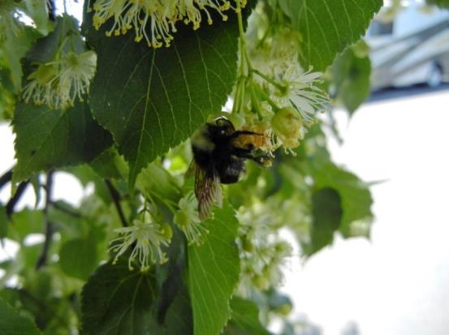
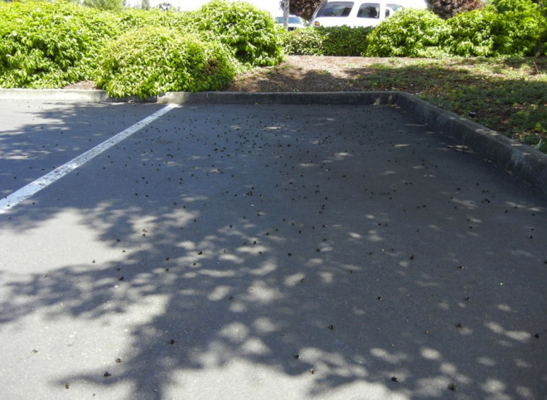
How Neonicotinoids and Bees Became a Crisis
for Greenhouse and Nursery Growers: the Last 16 Months
Start: June 20, 2013
Buzzkill: Huge bee die-off in Oregon parking lot blamed on insecticide spraying
Grist.org, Oregon Public Broadcasting
25,000 dead bumble bees and honey bees found in the parking lot of the Wilsonville Target Store
Linden trees in full bloom had been sprayed with Safari (dinotefuran)
Scott Hoffman Black, executive director of the Xerces Society, said he has confirmed the bees died from pesticide poisoning.
“Evidently they didn’t follow the label instructions. This should not have been applied to the trees while they’re in bloom.”

Slide 5
Feb 2014
Organic Consumers Association Website
Bee Science Articles
02/11/14 - GMO Soybeans Are Bad for Mexico's Beekeepers
02/20/12 - Study Says Insecticide Used with GM Corn Toxic to Bees
01/21/11 - Call to Ban Pesticides Linked to Bee Deaths
12/24/08 - Bee Learning Affected by Eating Toxin from GE Corn
08/26/08 - New Research Finds Higher-Than-Expected Levels of
Pesticides in Hives
05/08/08 - Honeybee Hives in U.S. Seeing Continued Decline
05/05/08 - Air Pollution Impedes Bees' Ability to Find Flowers
09/07/07 - Study Points to Virus in Collapse of Honeybee Colonies
05/04/07 - What's The Buzz? Scientists Explore Pesticide Poisoning
of Bees
04/26/07 - Requiem for the Honeybee

Slide 6
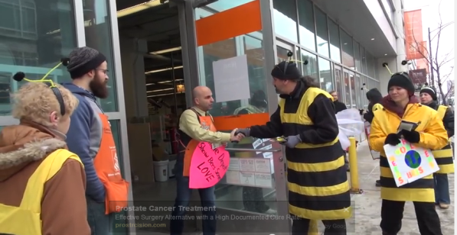
February 7, 2014
Join One of these Five Home Depot ‘Swarms’ to Help Save the Bees! Organic Consumers Association
For related articles and more information, please visit OCA's Honey Bee Health page and our Millions Against Monsanto page.
If you live in Eugene, Ore., the Bay Area (Calif.), Minneapolis, Minn., Washington D.C., or Chicago, Ill., you’re in luck. You can join activists from the OCA and other bee-friendly groups to help deliver valentines to local Home Depot store managers with this message: “Give Bees Some Love! Stop Selling Bee-Killing Plants!”
You can download your valentine, and add your own personal message. We even have leaflets you can print and hand out.

Slide 7
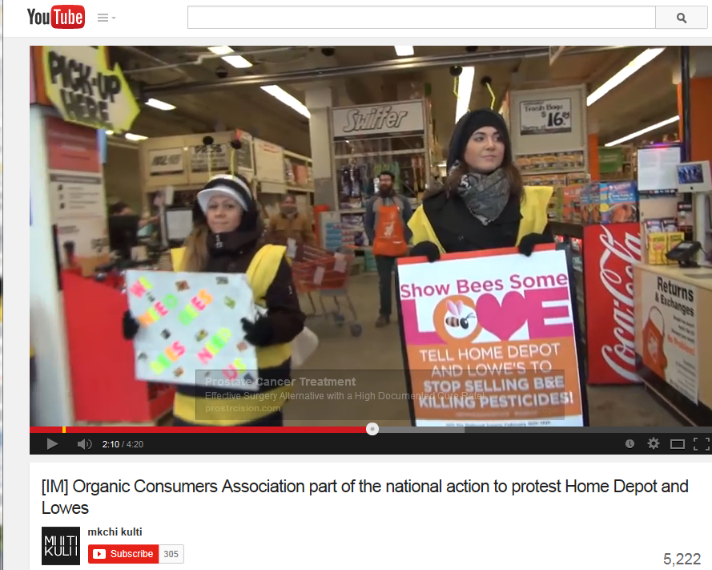
Feb 12, 2014: Organic Consumers Association Protest in Chicago

Slide 8

Feb 12, 2014
Organic Consumers Association Protest in Chicago at a Home Depot

Slide 9

March 2014
Buyers from Home Depot and Lowes contact
nursery and greenhouse growers to announce
that they may not be accepting plants treated with neonicotinoid insecticides, or that treated plants will need to be labeled.
How can they do that?
The large retail stores control the
lion-size of the flower and nursery
market. Contracts with these buyers
are highly competitive and may
involve millions of dollars in sales per year.
Neonicotinoid

Slide 10
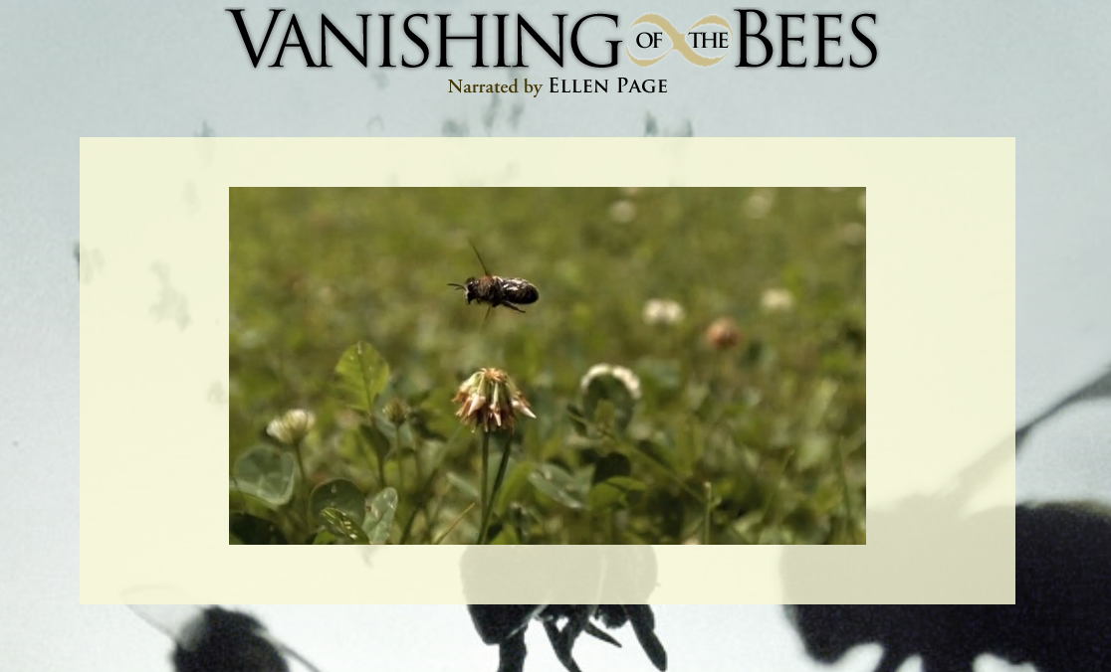
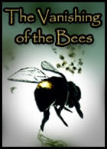

May 2, 2014
A New Documentary Film Exploring "Colony Collapse Disorder" and the Fate of Agriculture

Slide 11
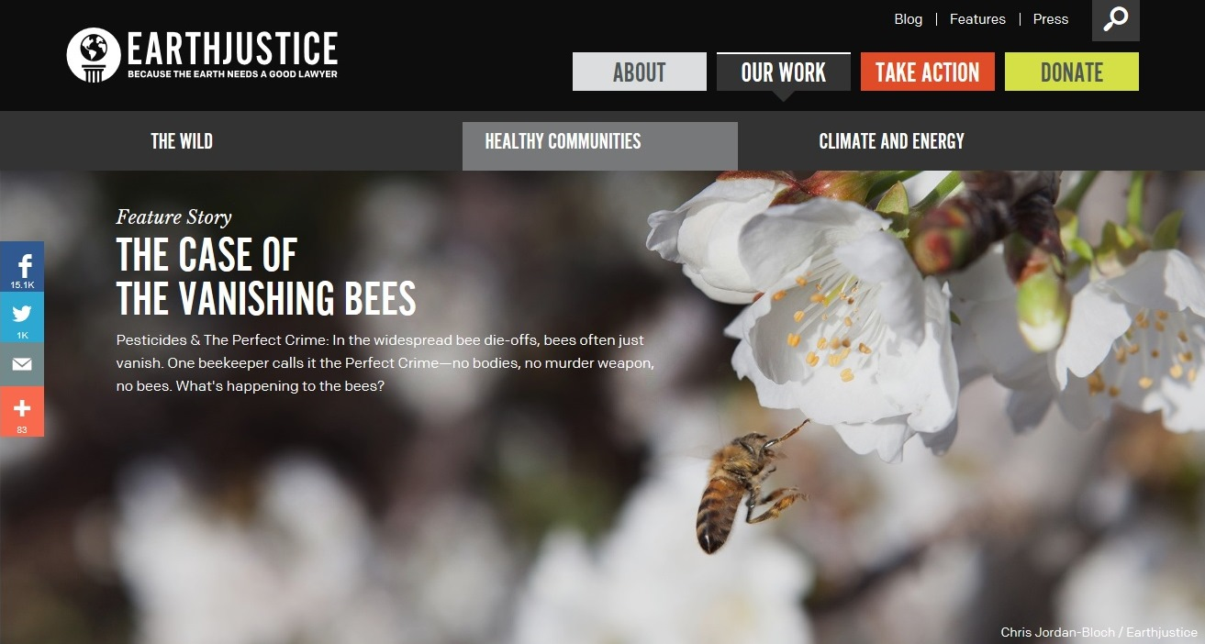
May 2, 2014
The Case of The Vanishing Bees
Pesticides & The Perfect Crime: In the widespread bee die-offs, bees often just vanish. One beekeeper calls it the Perfect Crime- no bodies, no murder weapons, no bees. What’s happening to the bees?

Slide 12

May 9, 2014
Harvard School of Public Health > News > Press Releases
Study strengthens link between neonicotinoids
and collapse of honey bee colonies (by Dr. Lu)
For immediate release: May 9, 2014
Boston, MA — Two widely used neonicotinoids
—a class of insecticide—appear to significantly harm honey bee colonies over the winter, particularly during colder winters, according to a new study from Harvard School of Public Health (HSPH). The study replicated a 2012 finding from the same research group that found a link between low doses of imidacloprid and Colony Collapse Disorder (CCD), in which bees abandon their hives over the winter and eventually die.

Slide 13
May 2014. 2nd Lu paper receives a lot of attention in the media
First paper: LU¹, WARCHOL² and CALLAHAN. 2012. In situ replication of honey bee colony collapse disorder. Bulletin of Insectology 65 (1): 99-106, 2012
Second paper: Lu C, Warchol KM, Callahan RA. 2014. Sub-lethal exposure to neonicotinoids impaired honey bees winterization before proceeding to colony collapse disorder. Bulletin of Insectology 67: 125–130.
Discussion of Lu papers
In a recent review, Cresswell suggests that “the field-realistic range of imidacloprid concentrations is assumed to be 0.7–10 μg L⁻¹ (ppb).
Dosages in first Lu paper: 20, 40, 200, or 400 ppb fed constantly to bees in sugar water. Also, symptoms of affected colonies may not match CCD.
Dosage in second Lu paper: 136 ppb fed constantly to bees in sugar water.
Concentration of imidacloprid or clothianidin in sugar water fed to bees continuously for 13 weeks is much higher than what is expected in the pollen of seed-treated field crops. But overall, these results are consistent with other papers where bees are fed neonicotinoid-tainted sugar water.

Slide 14
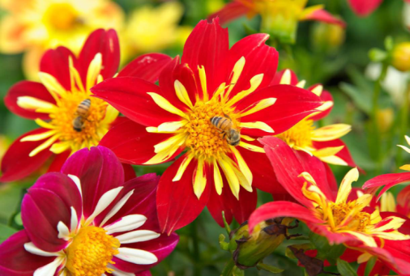
June 2014
Gardeners Beware 2014:
Bee-Toxic Pesticides Found in
“Bee-Friendly” Plants Sold at Garden Centers Across the U.S. and Canada
©Copyright June 2014 by Friends of the Earth
Report Summary (of a 60 page report):
Plants were purchased from retail nurseries, including Home Depot, Lowe's, Walmart, and Orchard Supply Hardware in 18 cities across the U.S., as well as three provinces in Canada.
They then sent the plants off to a laboratory to measure the presence and concentration of pesticides in the greenery.
Testing showed that 51 percent of store-bought plants had levels of a group of harmful pesticides known as neonicotinoids that were high enough to kill honey bees, bumble bees, and other pollinators "outright."

Slide 15
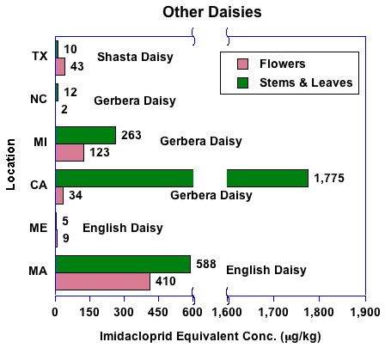
Gardeners Beware Report
Oral LD50
180 ppb, acute
50 ppb, chronic

Slide 16
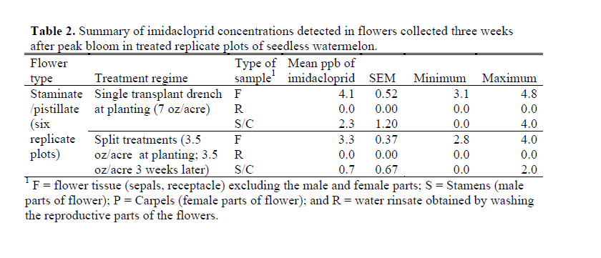
Determination of Imidacloprid Residue Concentrations
in Seedless Watermelon Flowers
Galen P. Dively, Mike Embrey, Terry Patton, and Amy Miller
Department of Entomology, University of Maryland

Slide 17
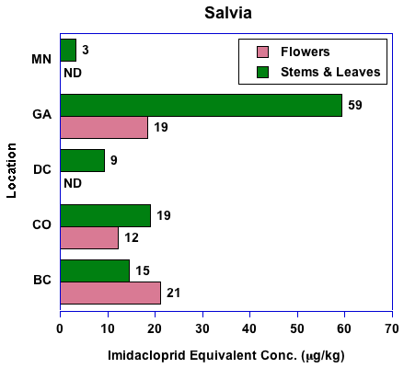

Slide 18
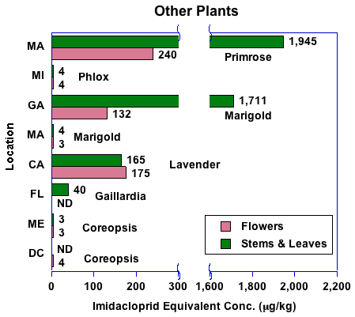

Slide 19
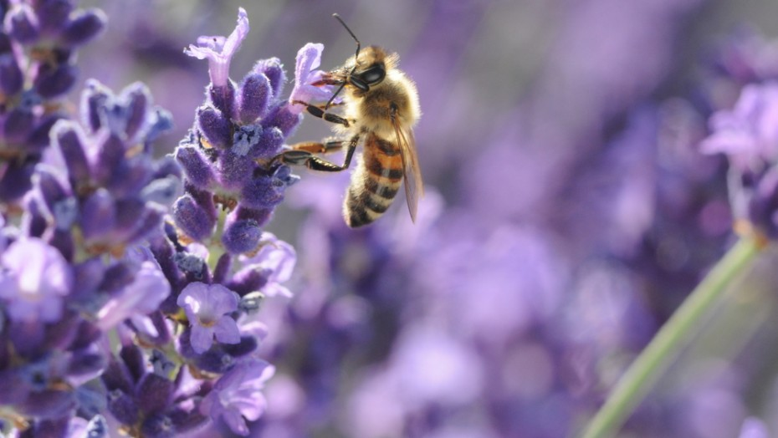
Are Your Store-Bought Plants Killing Bees?
+
June 25, 2014 Gardeners Beware Report Generates More News
Pesticides found in plants purchased at Home Depot or Walmart can prove deadly for bees. By Marina Koren Follow on Twitter
(SHUTTERSTOCK)
Neonicotinoids have previously been linked to the country's shrinking bee population. Last June, more than 50,000 bumblebees, or about 300 colonies, were found dead or dying in a Target parking lot in Oregon.
http://www.salon.com/2014/06/26/bee_friendly_plants

Slide 20
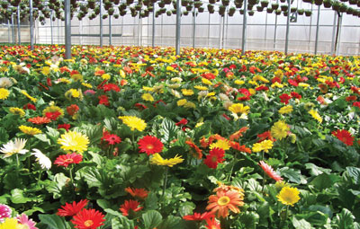
Impact on Greenhouse and Nursery Growers?
In 2015 Home Depot is requiring a label in each pot of plants treated with a neonicotinoid insecticide.
Two other retail store buyers have requested that no neonics be used but have not yet made a firm requirement

Slide 21
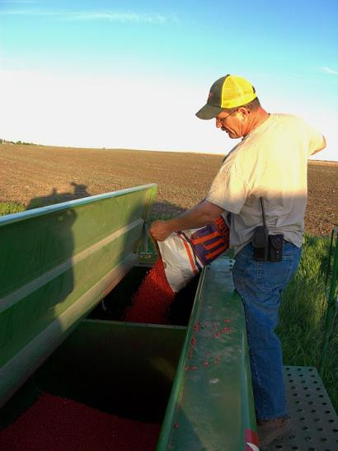
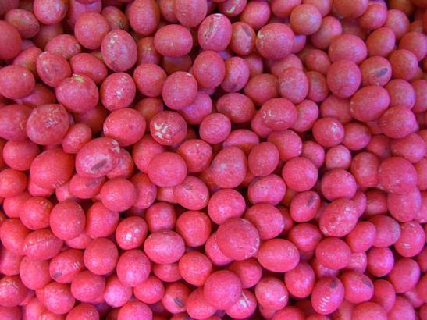
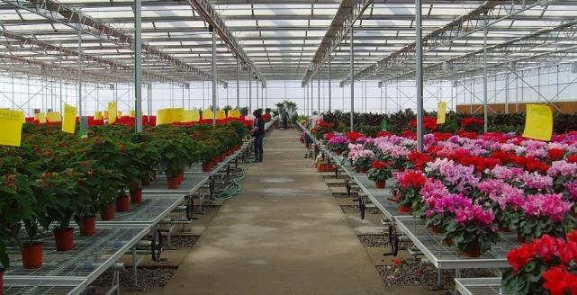
Questions Raised
Is the widespread use of imidacloprid and other neonics causing the decline of managed honey bees?
Are flowering plants sold in garden centers harmful to bees because of the use of pesticides during production?

Slide 22
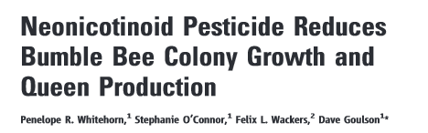
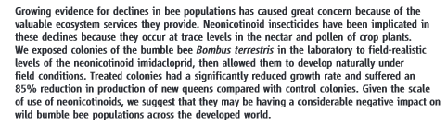
Several Key Papers Demonstrate Negative Effects of Neonics Fed to Bees at Field-Relevant Rates

Slide 23
Published in 2014, Purdue
Multiple Routes of Pesticide Exposure for Honey Bees
Living Near Agricultural Fields
Christian H. Krupke¹*, Greg J. Hunt1, Brian D. Eitzer², Gladys Andino¹, Krispn Given¹
¹ Department of Entomology, Purdue University, West Lafayette, Indiana, United States of America, ² Department of Analytical Chemistry, The Connecticut Agricultural Experiment Station, New Haven, Connecticut, United States of America
Most of the 92 million acres of corn planted across the U.S. this year will have been treated with either clothianidin or thiamethoxam as a seed treatment.
Plants visited by foraging bees (dandelions) growing near these fields
were found to contain neonicotinoids
Dead bees collected near hive entrances during the spring sampling period were found to contain clothianidin
We also detected clothianidin in pollen collected by bees and stored in the hive.
Maize pollen from treated seed was found to contain
clothianidin (3.5 ppb) and other pesticides; and honey bees in our
study readily collected maize pollen.

Slide 24
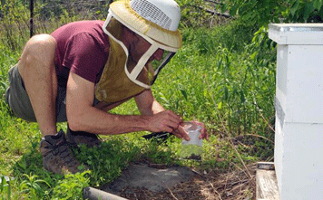
Extension publication by Iowa State:
Insecticidal Seed Treatments can Harm Honey Bees
Erin Hodgson, Department of Entomology (ISU) and Christian Krupke, Department of Entomology (Purdue)
http://www.extension.iastate.edu/CropNews/2012/0406hodgson.htm
Figure 1. Bees exhibit neurotoxic symptoms when dosed with neonicotinoids. Dying bees have trouble flying, collecting food and getting back into the hive. Photo by John Obermeyer, Purdue Extension Entomology.

Slide 25
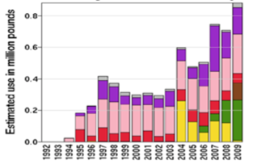
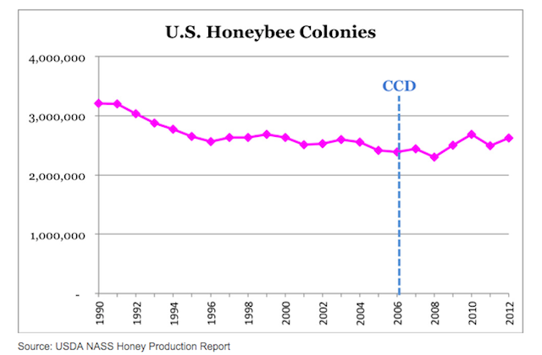
However, honey bee decline appears to have started before the widespread use of neonics.
Imidacloprid Use in Agricultural Crops in the USA
Varroa
Imidacloprid
Use begins

Slide 26
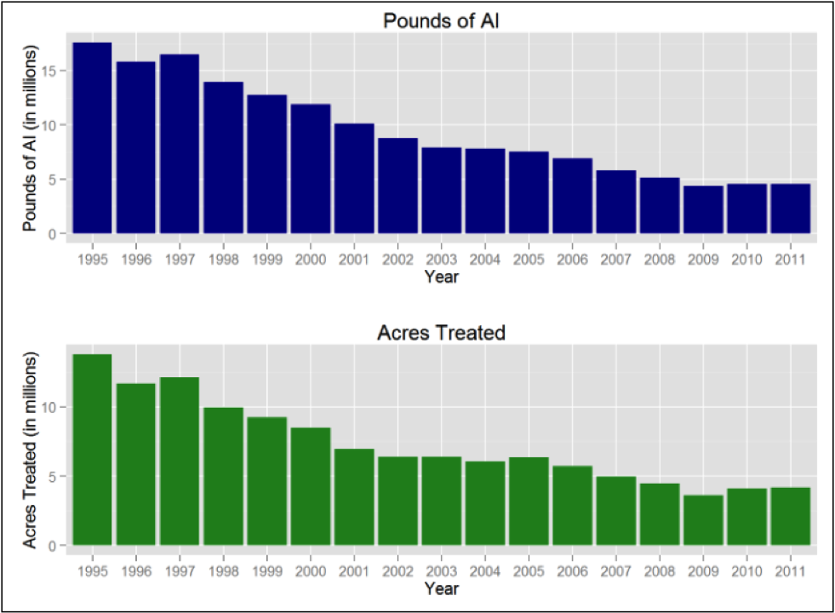
As the use of neonics increased by 0.8 million pounds from 1995 to 2009, the use of carbamates and organophosphates decreased by 20 million pounds. Randy Oliver

Slide 27
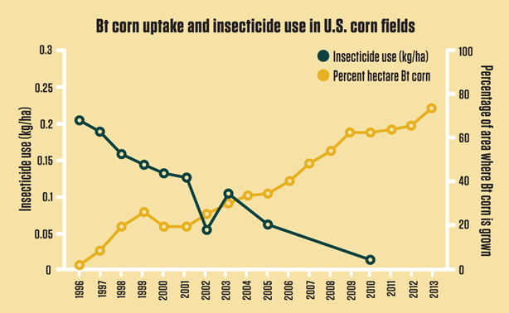

Slide 28
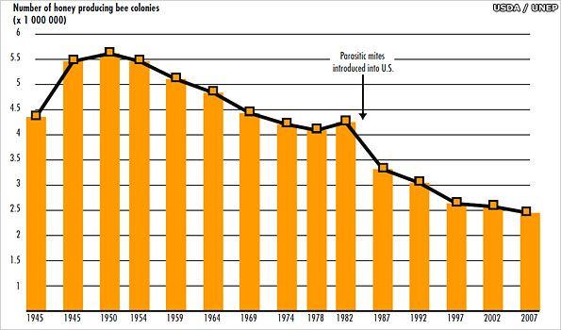
Randy Oliver, Scientific Beekeeping
Varroa mite found in 12 states
Imidacloprid starts here
1950 1970 1990 2010

Slide 29
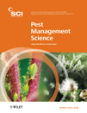
Dietary traces of neonicotinoid pesticides as a cause of population declines in honey bees: an evaluation by Hill's epidemiological criteria
James E Cresswell^{1,*},
Nicolas Desneux² and
Dennis vanEngelsdorp³
Pest Management Science
Volume 68, Issue 6, pages 819–827, June 2012
* 72 papers cited. Most of them are journal articles report the results of experiments with bees that relate to the neonic pesticide issue directly or indirectly.

Slide 30
Criterion | Brief description | Score
1. Experimental evidence |  | − 1 Mixed results
2. Coherence | Fails to contradict established knowledge | + 3
3. Plausibility | Probable given established knowledge | + 2 Yes
4. Analogy | Similar examples known | + 3 Yes
5. Temporality | Cause precedes effect | − 4 Years do not match
6. Consistency | Cause is widely associated with effect | − 4 Poor geographic match
7. Specificity | Cause is uniquely associated with effect | − 5 No
8. Biological gradient | Monotonic dose–response relationship | − 4
9. Strength | Cause is associated with a substantive effect | − 2 Weak
CONCLUSION: Dietary neonicotinoids cannot be implicated in honey bee declines, but this position is provisional because important gaps remain in current knowledge.

Slide 31
The United Kingdom Report
An assessment of key evidence about Neonicotinoids and bees
March 2013
Three recent studies with neonicotinoids showed sub-lethal effects on bees
These results contrast with a growing body of evidence from field studies that fail to show an effect of neonicotinoids when bees are allowed to forage naturally in the presence treated crops.
The Australia Report
Overview report on bee health and the use of neonicotinoids in Australia
February 2014
The introduction of the neonicotinoids has led to an overall reduction in the risks to the agricultural environment from the application of insecticides.
Australian honeybee populations are not in decline, despite the increased use of neonicotinoids in agriculture and horticulture since the mid-1990s.

Slide 32
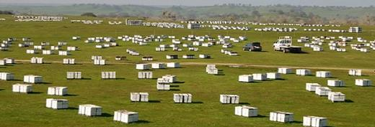
USDA Bee Research Lab
Extensive research on Colony Collapse Disorder suggests that there are many causes of this syndrome, with the most important causes being the interaction of several bee diseases with other stressors (USDA ARS 2014). At this time neonicotinoids are NOT considered to be a primary cause of Colony Collapse Disorder. However, recent research indicates that bees exposed to neonicotinoid insecticides may have suppressed immune systems, which could make them more susceptible to some bee diseases (Di Prisco et al. 2013).
Bee Lab Objectives:
1) diagnosing and mitigating disease, 2) reducing the impacts on bees of pesticides and other environmental chemicals, and 3) improving bee health through better nutrition

Slide 33
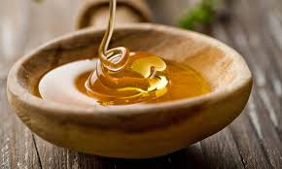
What do the Beekeepers Think?
http://scientificbeekeeping.com
Randy Oliver
As Dr. Eva Crane…has pointed out “the best that beekeepers can hope for, in the light of the great need to kill pest insects, is an acceptable level of mortality among their bees.”
Beekeepers realize that in order to get locations, that they need to get along with the landowners, who are often farmers (or friends of the farmers). If the beekeeper raises a stink, he may lose his welcome. So in general, commercial beekeepers accept the occasional bee kill as a normal cost of doing business.

Slide 34
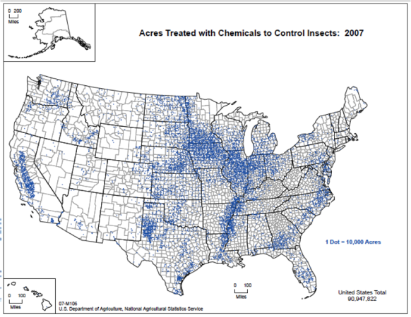
Is there a geographic correlation to neonic use as a seed treatment and bee decline? Iowa as a test case.
Figure 2. If you add up all the blue dots (each representing 10,000 acres treated with insecticides), it’s easy to see why in some areas it’s hard for beekeepers to find “safe” places for their hives. Source USDA.
http://scientificbeekeeping.com Randy Oliver

Slide 35
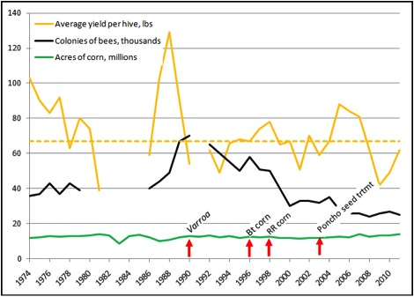
Honey yield per hive in Iowa, where GM crops are most intensively used, 1974 – 2010. Randy Oliver
Bt corn
20% Bt corn
60% Bt corn

Slide 36
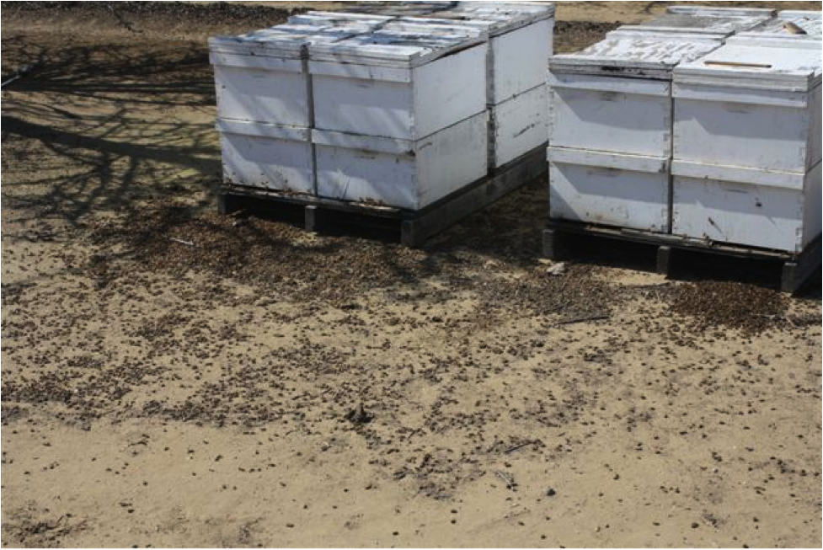
Figure 4. A bee kill in an almond orchard this spring. Surprisingly, no insecticides were involved! These bees were killed by a tank mix of herbicides, spray oil, and liquid fertilizer. A number of colonies were killed outright and others were weakened. http://scientificbeekeeping.com Randy Oliver

Slide 37
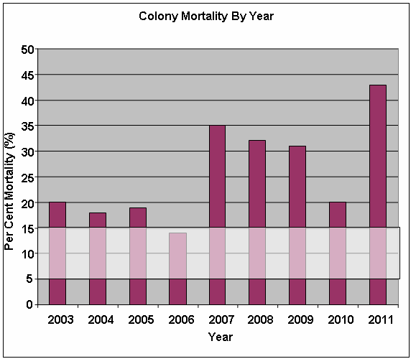
Investigation of honey bee winter mortality in Ontario
Ontario Ministry of Agriculture
Figure 1: Estimated mortality of honey bees in Ontario. The light colored horizontal bar represents the normal level of mortality derived from a literature review.

Slide 38
Beekeeper Survey - 2011 Winter Loss Report for Apiculture in Ontario
Based on research from the University of Guelph (Guzman et al., 2010) and reports and field observation from other provinces (Currie et al., 2010), varroa is still the main factor in colony mortality. The overall virulence of Nosema ceranae in honey bees is somewhat unclear and there are many other pathogens such as viruses that have a further impact on honey bees.
Paul Kozak
Provincial Apiarist
Ontario Ministry of Agriculture, Food and Rural Affairs
Email: Paul.Kozak@ontario.ca

Slide 39
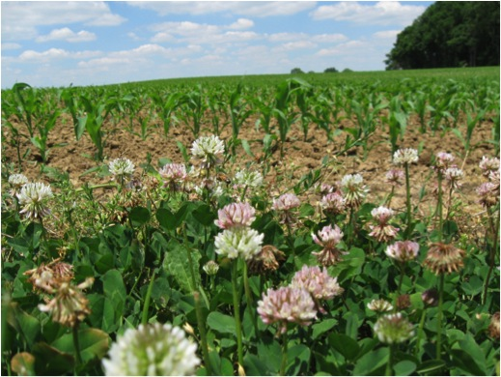

Overall: How much do trace amounts of neonics in the pollen and nectar of crops planted with treated seed impact bees? Unresolved. An equivalent concentration in sugar water fed to bees causes problems, Purdue study found clothianidin in bee pollen, but field data showing decline of colonies due to seed- treated field crops is still lacking.
What about planter box dust during planting? Definitely a problem if bees visit weed flowers along the edge of field at planting time or shortly after.

Slide 40
What About Neonic/DMI Synergism?
Insecticide | Fungicide pretreatment | LD50 (µg/bee)
Acetamiprid | None | 7.07
Acetamiprid | Propiconazole | 0.07
Thiacloprid | None | 14.6
Thiacloprid | Propiconazole | 0.03
Imidacloprid | None | 0.018
Imidacloprid | Propiconazole | 0.012
DMI pretreatment makes Acetamiprid and Thiacloprid as toxic to bees as imidacloprid (otherwise they are 200-fold less toxic).
Little effect on imidacloprid
T. Iwasa et al. / Crop Protection 23 (2004) 371–378

Slide 41
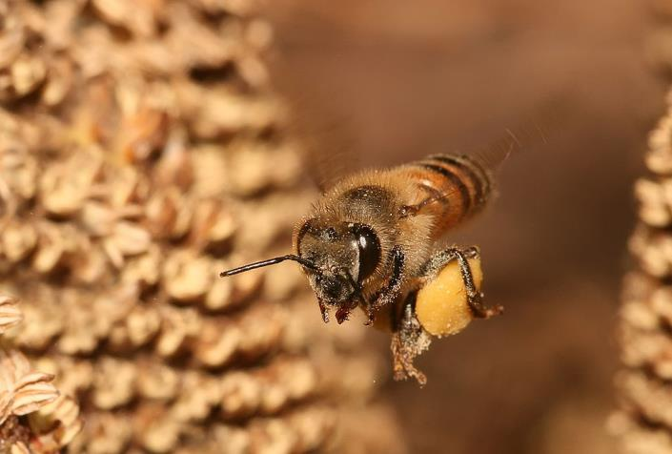
So, the role of neonics in causing bee decline is being intensely debated and researched without a clear answer at this point.
But it doesn’t matter- the public eye has been focused on garden center plants, and we need to grow plants that are safe for bees and other pollinators
Note: Greenhouses in Europe are exempt from the temporary ban on neonicotinoids

Slide 42
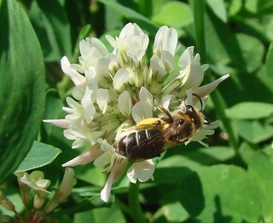


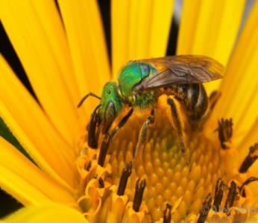

What Do We Know About the Safety of Neonics Used on Greenhouse and Nursery Plants?
Two studies with ladybird beetles and butterflies on soil drenched nursery plants by Vera Krischik
John Ascher
Two studies with clover in turf by
JL Larson, CT Redmond, DA Potter
Two experiments with greenhouse-grown flowers for garden centers by Smitley
©Alex Wild

Slide 43
From Krischik, UMinn: Nursery plants treated with Marathon soil app.

Slide 44
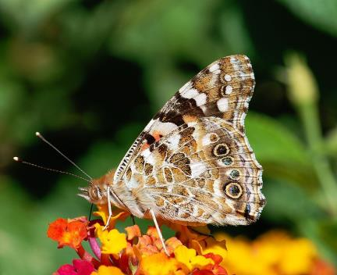
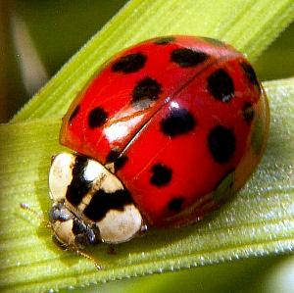
Landscape rates of soil-applied imidacloprid translocated to flowers reduces survival of Coleomegilla, Hippodameia, and Cocinella ladybeetles, but not Harmonia ladybeetles, Danaus plexippus, and Vanessa cardui, butterflies
Vera A. Krischik, Mary Rogers, Garima Gupta, and Aruna Varshey
Survival and fecundity of both butterfly species was not reduced in free-ranging or force-fed experiments (0 ppb (C), 15 ppb (1X), or 30 ppb (2X) imidacloprid) experiments.
However, butterfly larval survival was significantly reduced on 1X and 2X imidacloprid treatments
Three (Coleomegilla maculata, Harmonia axyridis, and Hippodamia convergens) of the four lady beetle species had significantly reduced survival at day 12 from both 1Xand 2X treatments.

Slide 45
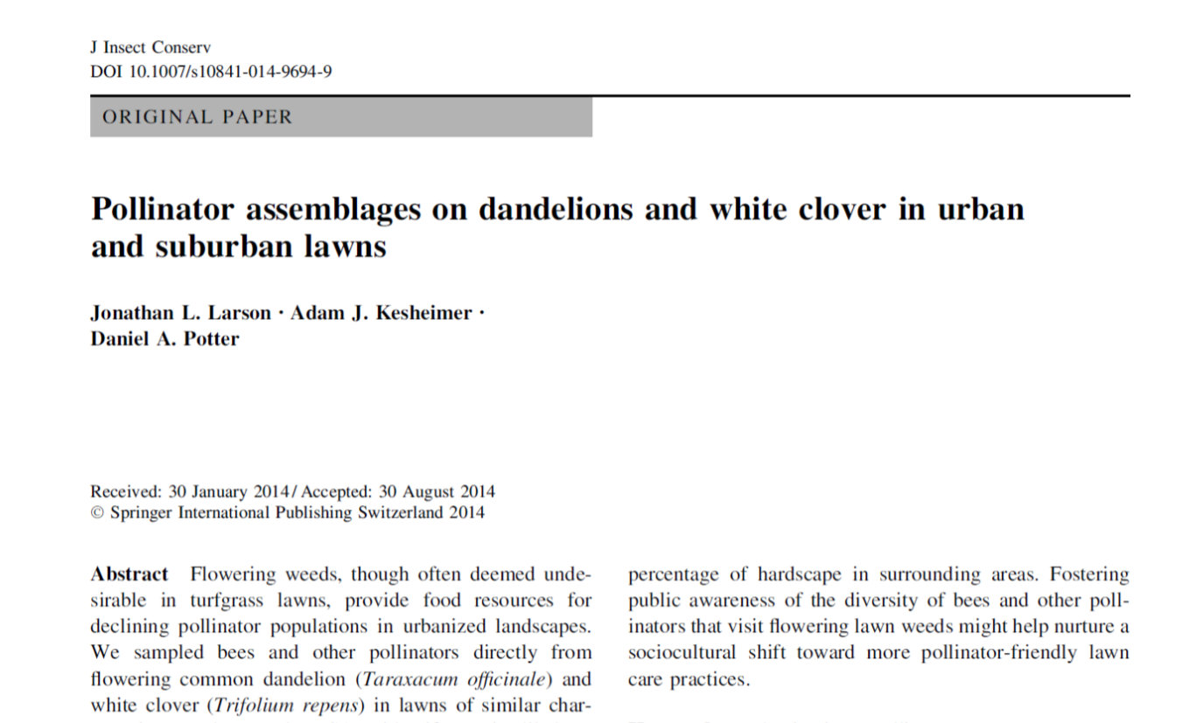
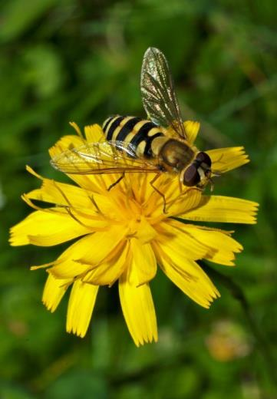
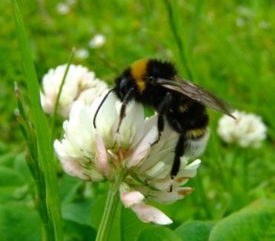
Published Sept. 2014
Larson and Potter, Kentucky lawns
More than 50 spp. of pollinators found
on dandelions and white clover in lawns

Slide 46
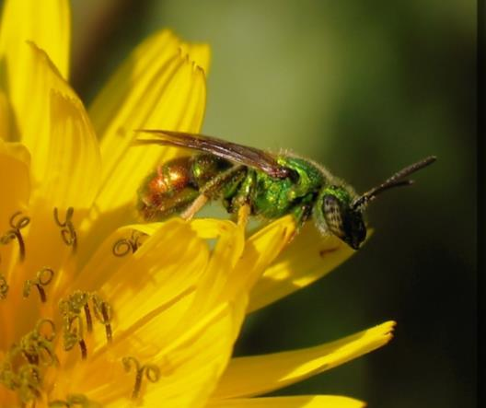
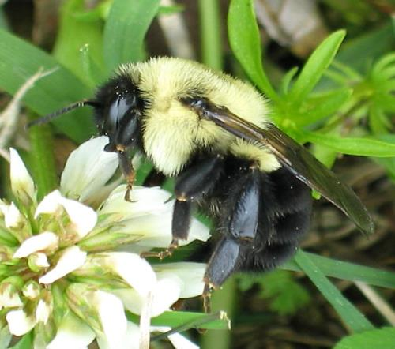
Objectives of Potter Study
Evaluate hazards of lawn insecticides to bees in the field
Find ways to reduce the risks of harm

Slide 47
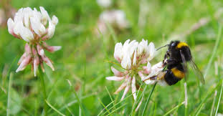
Assessing Insecticide Hazard to Bumble Bees Foraging
on Flowering Weeds in Treated Lawns
Jonathan L. Larson, Carl T. Redmond, Daniel A. Potter*
Department of Entomology, University of Kentucky
1. PLoS ONE 8(6): e66375. doi:10.1371/journal.pone.0066375
2. Larson, Redmond & Potter 2014; Environ. Tox. Chem., In Press
naturespotted.wordpress.com

Slide 48
Results of Kentucky Study
When bumble colonies were caged 24 h after turfgrass with clover was sprayed, and kept their for 2 weeks:
For Clothianidin- the number of foraging bees was reduced by 75% and no new queens produced (compared with 35 queens in control plots)
For chlorantraniliprole (Acelepryn)- No difference from control treatment
For lawns mowed before spraying- No effect on the bees
naturespotted.wordpress.com

Slide 49
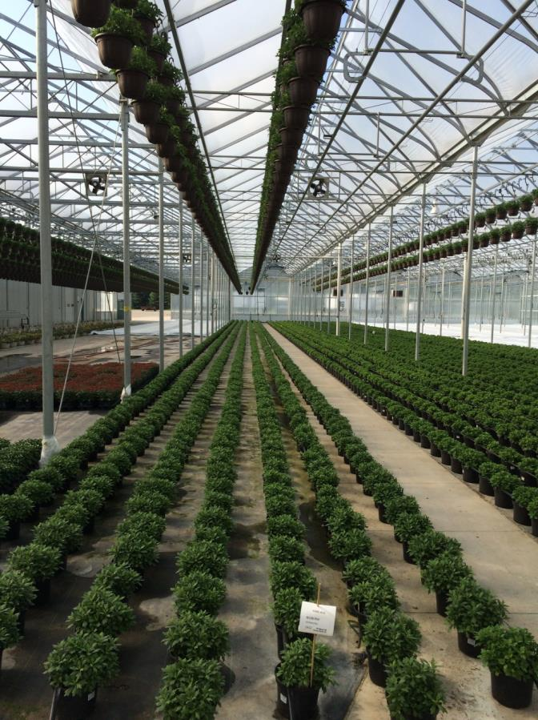
For Garden Center Plants:
What are the biggest potential problems for bees if neonicotinoids are used?
Spraying open flowers during the last few weeks before shipping (with any insecticide).
Soil drenches in greenhouses with imidacloprid, primarily used in hanging baskets
Soil drenches of flowering trees (Tilia) in nurseries or in yards for Japanese beetle, etc.

Slide 50
Three Experiments With Greenhouse and Nursery Plants
Smitley, MSU
Evaluate the impact of an imidacloprid soil drench applied to 12” diameter hanging baskets
Determine the amount of dislodgable residue of imidacloprid on flowers purchased in a garden if the flowers received a foliar spray of imidacloprid at 1, 2 and 4 weeks prior to the shipping date.
Determine the impact of an imidacloprid soil drench applied around the base of Tilia trees after petal-fall on bumble bees the following year.

Slide 51
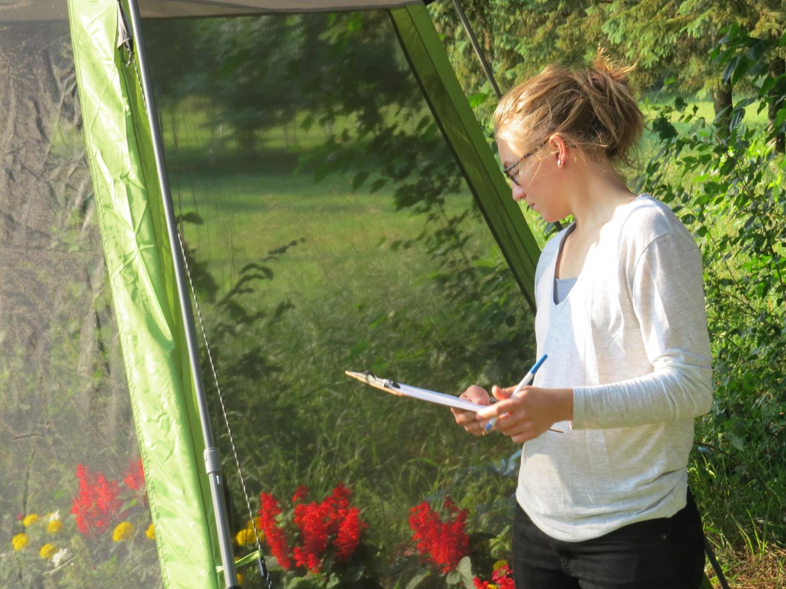
Experiment I:
Imidacloprid applied to hanging baskets as a soil drench

Slide 52
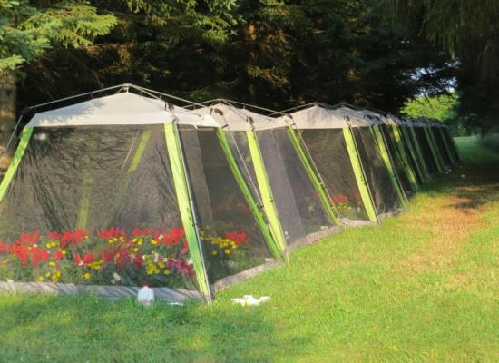

Methods:
Hanging baskets were drenched at 4 weeks before shipping
5 weeks after the drench plants were put in screen cages with colonies of bumble bees
Bumble bees remained in screen cages for 3 weeks
Colonies were counted three times, at 1, 3 and 6 weeks after being put in screen cages

Slide 53


Slide 54


Slide 55

The only way to count bumble bees is to paint each one when it is counted!
Photo by Cristi Palmer, IR4

Slide 56

Counting bumble bees in the cold room with a red light
Photo by Cristi Palmer

Slide 57
Bumble Bees Per Colony After Soil Drench With Imidacloprid or Water (Control)
Date | Treatment | Number of Bees Counted Per Colony | New Queens Produced Per Colony
July 14 | Imidacloprid | 105
July 14 | Control | 133
July 28 | Imidacloprid | 87
July 28 | Control | 96
August 18 | Imidacloprid | 22 | 0.6
August 18 | Control | 18 | 1.0

Slide 58
Results:
No significant differences in the total number of bees counted on any sample date
No differences in number of queens produced at the end of the summer
Problems:
Poor survival of all colonies after being put into the field
Questions:
Are there any sublethal effects?
How important is nutrition (flowers available)

Slide 59

Experiment II
Determine the last time that foliar sprays can be applied to open flowers, and still be safe for bees
Flowers were sprayed with imidacloprid at 4, 2 and 1 week before shipping.
Flowers were sampled 1 week after the shipping date

Slide 60
Weeks Before Shipping | Plant Type | Olefin (ppb) | Imidacloprid (ppb)
1 | Portulaca | 70 | 110*
1 | Verbena | 0 | 70
1 | Salvia | 20 | 200
1 | Marigold | 0 | 0.6
2 | Portulaca | 0 | 0
2 | Verbena | 30 | 430
2 | Salvia | 30 | 0
2 | Marigold | 0 | 0
4 | Portulaca | 0 | 0
4 | Verbena | 0 | 0
4 | Salvia | 0 | 0
4 | Marigold | 0 | 0
*Data are means of 10 replications

Slide 61

Results of Experiment II
Dislodgable residues were measured on 4 types of flowers
> 20 ppb were only found on dislodgable residue samples from flowers sprayed 1 or 2 weeks before shipping.
Conclusion- Avoid spraying open flowers the last 2 weeks before shipping.
Note: Samples were also
collected for whole-flower
tissue analysis pending
funding of the Specialty
Crop Block Grant.

Slide 62

Can we make guidelines that if followed can be used to label plants as bee-friendly?
Guidelines will be based on the first year of on-going research, and will include:
Do not spray flowers in the last 2 – 3 weeks before shipping
Do not apply soil drenches of imidacloprid to hanging baskets any later than 5 weeks before shipping. Do not exceed the label rate.
Do not use imidacloprid soil drenches on
flowering trees and shrubs attractive to bees.
Read bee warning information on pesticide labels
and avoid practices that are harmful to bees.

Slide 64

If bee-friendly management strategies are followed then-
Planting annual flowers, perennial flowers, and flowering trees and shrubs should help bees by providing more food for them. Encouraging wildflowers and flowering weeds is also good for bees.

Slide 65

Media Attention to Bee Issues Also Has Some Benefits:
People are more aware of the role of pollinators and their diversity
Where flowers are present, bees are indicators of the health of the insect community. Protecting bees protects all beneficial insects and biological control.

